Slide 1

ASP.NET 5 Workshop
Damian Edwards / Jon Galloway

Slide 2
Agenda
Day 1
ASP.NET 5 What and Why
Visual Studio and Command Line Tools for ASP.NET 5
Lab
ASP.NET MVC
ASP.NET MVC Web API
Lab
ASP.NET 5 Internals Deep Dive
Lab
Dependency Injection and Unit Testing

Slide 3
Agenda
Day 2
Entity Framework 7
Lab
Advanced Views and Tag Helpers
Front-end Dependencies and Automation with npm, Bower, Grunt and Gulp
Single Page Applications with ASP.NET 5
Lab
Migrating Applications to ASP.NET 5
Cross-platform Development with ASP.NET 5
Lab
Conclusion and Next Steps

Slide 4
Labs / Slides
http://aka.ms/ndc-aspnet5
https://github.com/jongalloway/ndc2015-aspnet5-workshop

Slide 5
ASP.NET 5 What and Why
Jon Galloway
Tech Evangelist
ASP.NET / Azure

Slide 6
.NET in 2015

Slide 7

History of .NET “verticals”
.NET
Windows Desktop
Windows Store
Windows Phone
ASP.NET 4
ASP.NET 5
App
Model
App
Model
App
Model
App
Model
App
Model
Framework
Framework
Framework
Runtime
Framework
Runtime
Runtime
Framework
Runtime
Runtime

Slide 8




.NET 2015
.NET Framework 4.6
.NET Core 5
Common
Runtime
Compilers
NuGet packages
Next gen JIT
SIMD
.NET Compiler Platform
Languages innovation
.NET Core 5 Libraries
.NET Framework 4.6 Libraries

Slide 9
.NET Framework 4.6
.NET Framework 4.6
Highly compatible, in-place replacement for .NET 4, 4.5, 4.5.1, and 4.5.2
Full support of any .NET API and Libraries in the market
WPF is the platform of choice for desktop application development
ASP.NET 5 is also supported running on top of .NET 4.6
.NET 4.6 also gets the investment on new compilers, new Jit, and languages innovation
Evolution in time
.NET
Framework
4.5.2
.NET
Framework
4.5.1
.NET
Framework
4.5
.NET
Framework
4

Slide 10


What is .NET Core
ASP.NET 5
App Model
Universal Windows Apps Model
Any other
app model
.NET Core
Unified BCL
(Base Class Library)
Runtime Adaption Layer
Core CLR
.NET Native
and Runtime
Other Runtime

Slide 11

NuGet is mainstream in .NET Core
.NET Core

Slide 12
.NET 2015 – 10K foot view
WPF
Windows Forms
ASP.NET (4 & 5)
ASP.NET 5
Universal Windows Apps
Core CLR
.Net Native
.NET Framework 4.6
.NET Core 5
Full .NET Framework for any scenario and
library support on Windows
Modular libraries & runtime optimized for server and cloud workloads
Common
Runtime Components
Compilers
NuGet packages
Next gen JIT (RyuJIT)
SIMD
.NET Compiler Platform (Roslyn)
Languages innovation
.NET Core 5 Libraries
.NET Framework 4.6 Libraries

Slide 13
.NET Compiler Platform (“Roslyn”)
Scenarios/usage cases
C#
VB
Language and IDE
FROM
Isolated/closed compilers
Hard to extend dev experience
API
VS dev experience extensibility
TO
API: open platform
Rich IDE experiences/refactoring
Code analysis
Custom diagnostics
Open Source compilers
OSS
Open Source

Slide 14
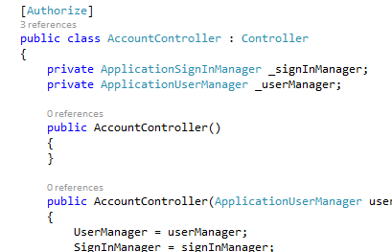
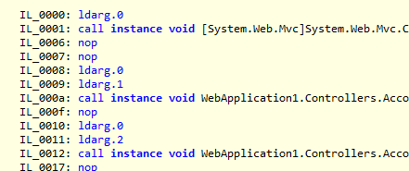

Code / Build / Debug
Deploy & Run
Roslyn takes your code and compiles it to IL. You have very modular references to the BCL and App Model you’re targeting.
References are built with your app into one native dll deployed locally with runtime
my.exe (stub)
my.dll
.NET Native tool chain
Code
(my.cs)
WinStore
.NET Native Runtime
Roslyn
IL
my.dll
+referenced dlls
ASP.NET
JIT Compiler
(RyuJIT)
+
+
CoreCLR
BCL
App Model
References & CoreCLR are deployed with app locally, JIT compilation on start up
References (Modular, NuGet)

Slide 15
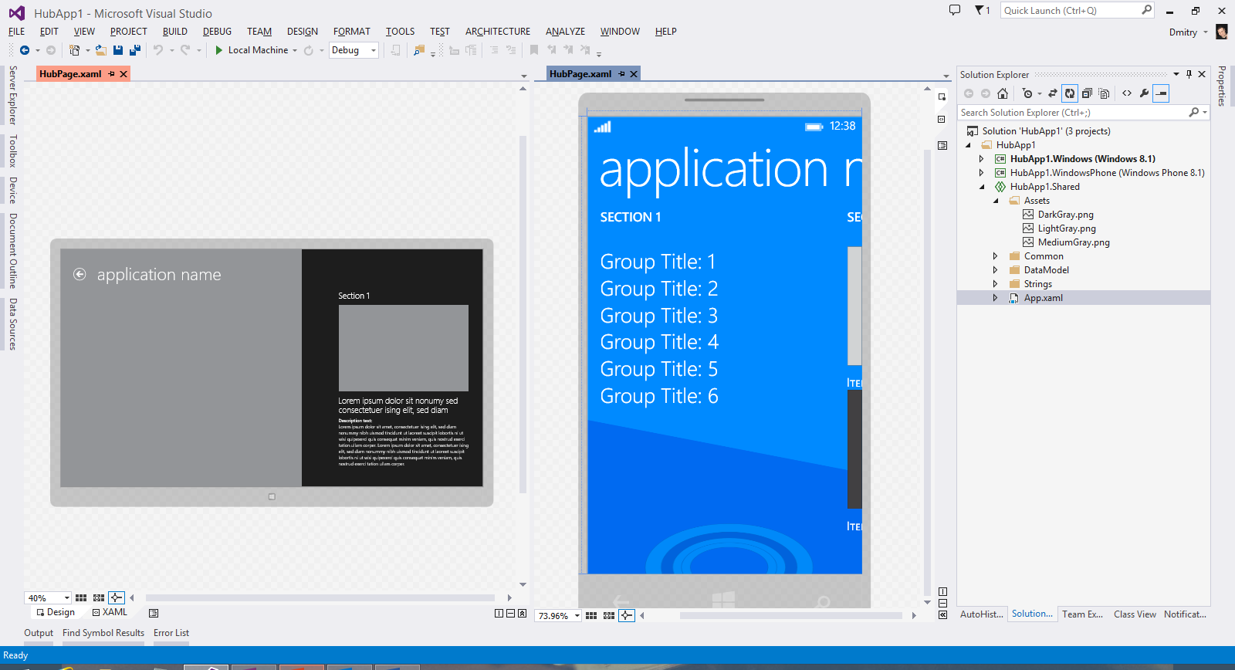

Universal Windows Platform
Universal Windows Platform
Universal Windows Platform
Shared across Windows and Windows Phone apps
.NET Native highlights
Next Generation Compiler in the Cloud for Store Apps
Uses lean runtime and VC++ optimizer for fast code execution and reduced memory usage
Preview available from Visual Studio http://aka.ms/dotnetnative
.NET Native
Native code compilation

Slide 16

Open Sourcing .NET
Platforms
General purpose .NET Core runtime, compilers and libraries
ASP.NET 5 web server stack
Fully Supported cross-platform
Windows, Linux and OS X
Visual Studio tooling support (e.g. debugging and deploying to Docker in Linux)
Omnisharp extensions to cross-plat IDEs (Sublime, Emacs…)
Open Source
.NET Core and ASP.NET 5 source being developed on GitHub
Contributions accepted, tested and fully supported
Close collaboration with Mono community
What is Microsoft Open Sourcing?
.NET 2015
.NET
Framework 4.6
.NET
Core 5
Common
Runtime components
Compilers
Libraries
.NET Compiler Platform
(“Roslyn”)
Languages
.NET Core 5 Libraries
.NET Framework 4.6 Libraries
RyuJIT, SIMD
Core-CLR
Get started from:
github.com/microsoft/dotnet

Slide 17
How does ASP.NET fit in?

Slide 18
ASP.NET 5
Unified framework for MVC, Web API and SignalR
.NET Framework 4.6 stack and libs
.NET Core 5 stack and libs
Full .NET Framework for any scenario and library support
Small runtime optimized for server and cloud workloads

Slide 19
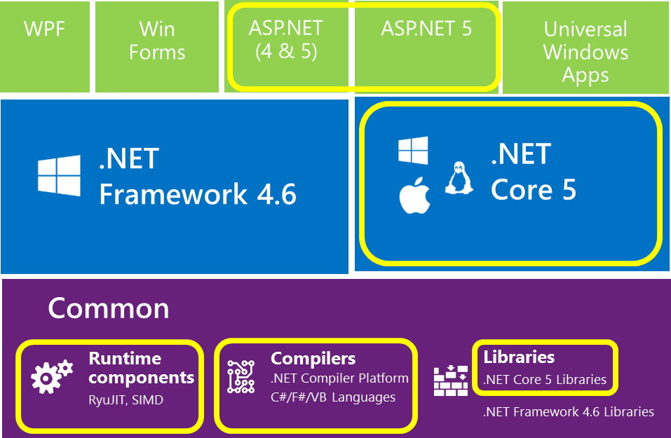
What is Open Source?

Slide 20
MSBuild -> csc.exe
CodeDOM -> csc.exe
Application
DNX (Roslyn)
Loose, GAC, NuGet
Libraries
NuGet
Open Source
FCL, GAC, NuGet
Application Frameworks
NuGet
IIS
Web Server
IIS, HTTP.SYS
Kestrel
System.Web
Application Host
DNX
.NET BCL & FCL
Platform Libraries
.NET BCL & FCL
.NET on NuGet
.NET CLR
Runtime
.NET CLR
.NET Core CLR
IIS: WebEngine4.dll
Exe: OS
Runtime Loader
DNX
Windows
Operating System
Windows, OSX, Linux

Slide 21
History of ASP (18+ years)
1996 – Active Server Pages (ASP)
2002 – ASP.NET
2008 – ASP.NET MVC
2010 – ASP.NET Web Pages
2012 – ASP.NET Web API, SignalR
2014 – ASP.NET 5 (and the Core CLR)

Slide 22


ASP.NET and the Modern Web
Totally Modular
Faster Development Cycle
Seamless transition from on-premises to cloud
Choose your Editors
and Tools
Open Source with Contributions
OSS
Cross-Platform
Fast

Slide 23
Modern Web - Agility
Faster Development Cycle
Features are shipped as packages
Framework ships as part of the application
More Control
Zero day security bugs patched by Microsoft
Same code runs in development and production
Developer opts into new versions, allowing breaking changes

Slide 24
Modern Web - Fast
Runtime Performance
Faster startup times
Lower memory / higher density (> 90% reduction)
Modular, opt into just features needed
Use a raw socket, framework or both
Development productivity and low friction
Edit code and refresh browser
Flexibility of dynamic environment with the power of .NET
Develop with Visual Studio, third party and cloud editors

Slide 25
Modern Web - Cloud
Seamless transition from on-premises to cloud
Cloud ready
Configuration
Session
Cache
Diagnostics
Run/Debug in Cloud
Tracing/Logging without re-deploy

Slide 26
Modern Web – Cross Platform
Runtime
Windows, Mac, Linux
Editors
Visual Studio, Text, Cloud editors
No editors (command line)
OSS
Open Source with Contributions

Slide 27
ASP.NET 2015 in a Nutshell
Visual Basic 14
Visual Basic 14 (coming soon)
C#
Web
Forms
MVC 5.x
Web API 2.2
MVC / Web API 6
ASP.NET 4.6 System.Web
ASP.NET 5
Core CLR
.Net Native
.NET Framework 4.6
.NET Core 5
Full .NET Framework for any scenario and
library support on Windows
Modular libraries & runtime optimized for server and cloud workloads

Slide 28
ASP.NET 5 - Compatibility
Web Forms, MVC 5, Web API 2, Web Pages 3, EF 6
Fully supported on .NET 4.6
MVC, Web API, EF 7
Breaking changes:
New Project System
New Configuration System
MVC / Web API / Web Pages merge
No System.Web, new Lightweight HttpContext (not System.Net.Http)
.NET 5 on Core CLR
Subset of the .NET Full Framework
Things you depend on might not be available yet

Slide 29
ASP.NET 5 - Summary
MVC 6 (MVC + Web API + Web Pages)
Feature | Running on .NET 4.6 | Running on .NET Core 5
Cloud Ready | * | *
Modular Design | * | *
Dependency Injection | * | *
Consistent Tracing / Debugging | * | *
Faster Development (No Build Step) | * | *
Open Source | * | *
Full Side by Side (framework deployed inside application) |  | *
Fast startup, Low memory / High throughput (best of class) |  | *

Slide 30
ASP.NET 5 resources
Get started at http://www.asp.net/vnext
GitHub project at https://github.com/aspnet/home

Slide 31
In Review: Session Objectives And Takeaways
Session Objective:
ASP.NET 5: What and Why
Key Takeaway:
ASP.NET 5 is an open-source and cross-platform framework for creating modern, cloud-based Web applications.

